Slide 1


How to automatically compare two Power BI reports?
Ilija Tavchioski
prof. dr. Erik Štrumbelj Vid Smrke
31 May 2023
Ljubljana, Slovenia

Slide 2

Introduction
Data migration
Completeness check
Data sampling
In516ht proposal

Slide 3
What is a Power BI report?
A software for creating interactive and dynamic visualizations of data
Features such as: filtering, calculating measurements, slicing data
The dataset is queried of the database
Each visualization is created of the calculations from the data

Slide 4
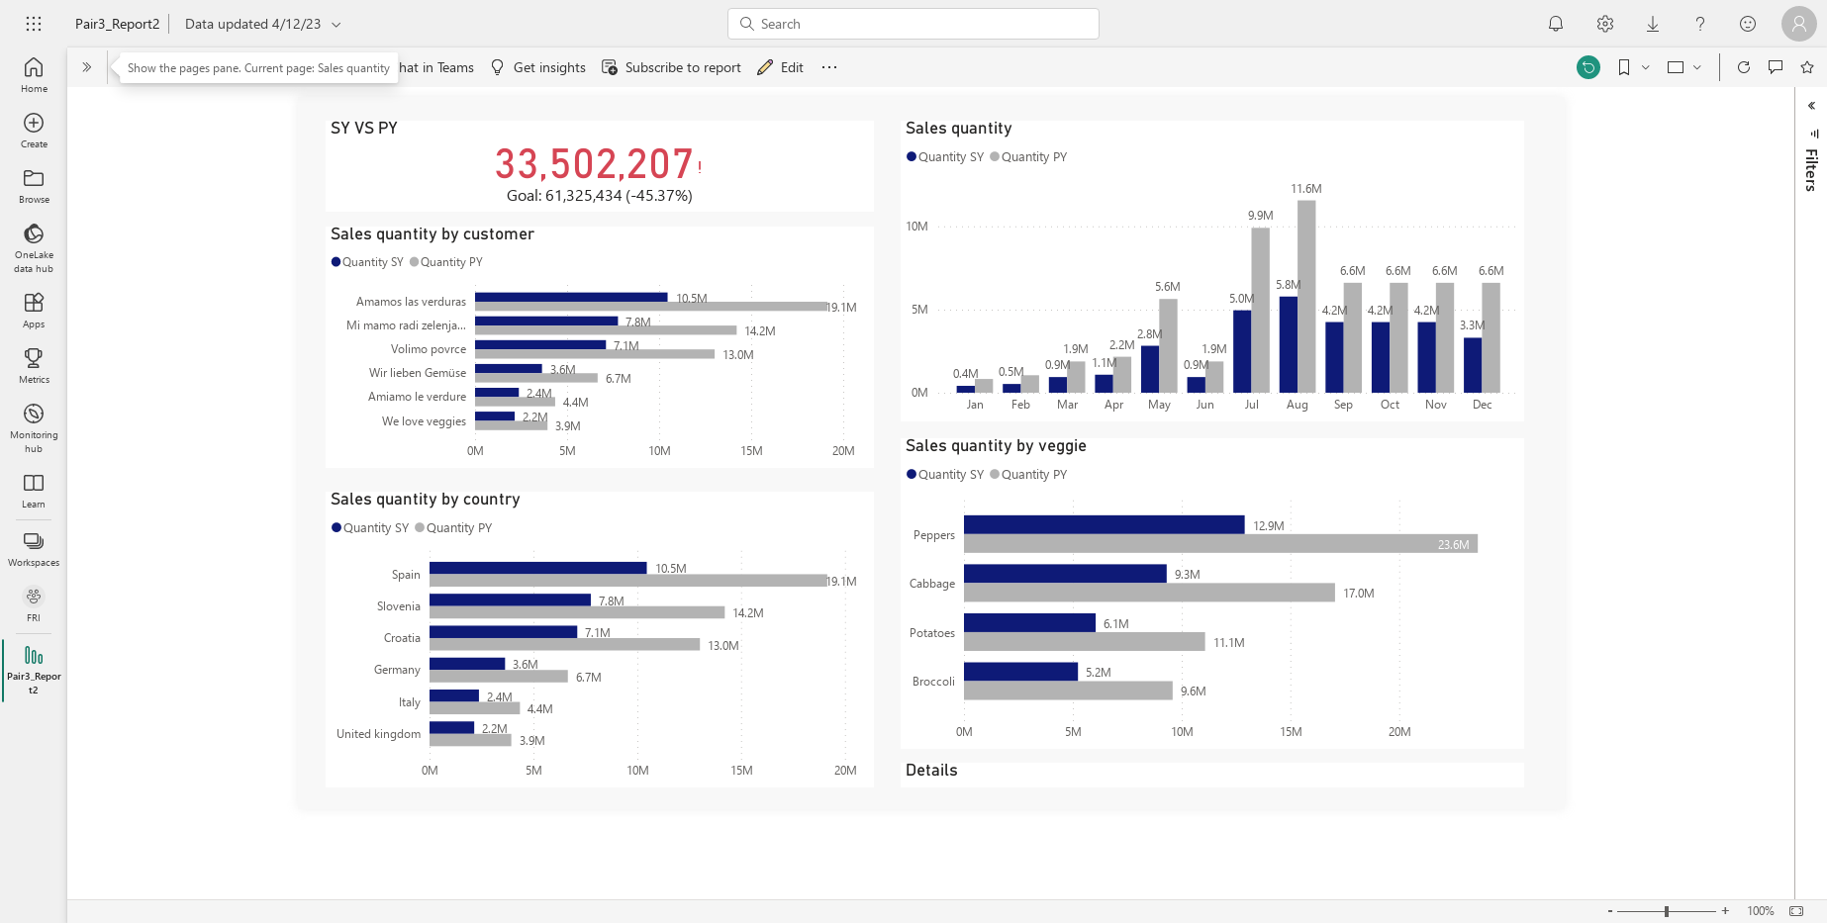

Slide 5
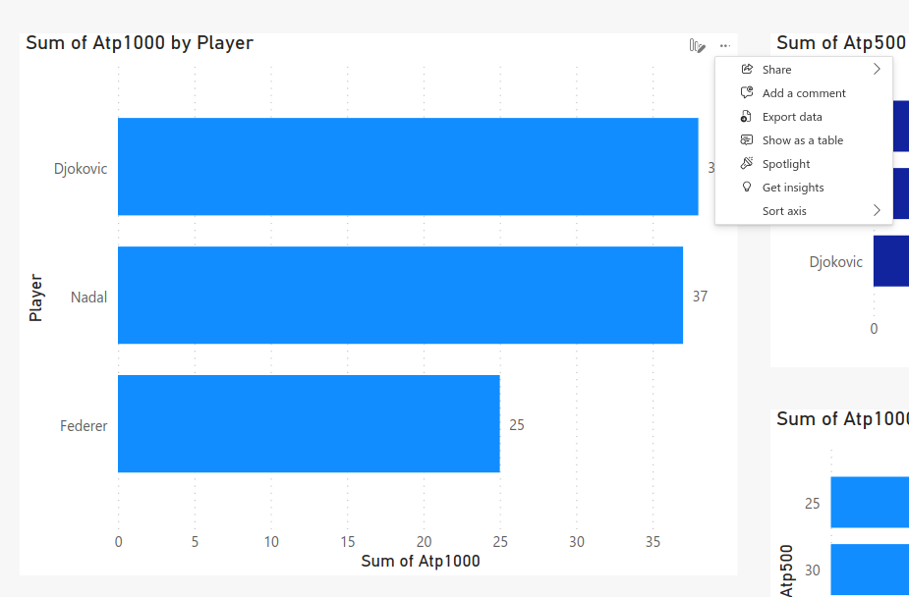
Data visualization
More options
Export data
Downloaded CSV file

Slide 6
Challenges
How to extract the data?
Power BI API
Power BI Desktop
Python crawler
How to compare the data?
Unknown key value!
Permuted rows or columns are not interpreted as difference

Slide 7

Software development
Command Line Application implemented in Python
Input: Two Power BI reports
Data Extraction
Data Comparison
Output: comparison report in Excel
Username, Password, WorkspaceID, ReportID, DataFolder

Slide 8
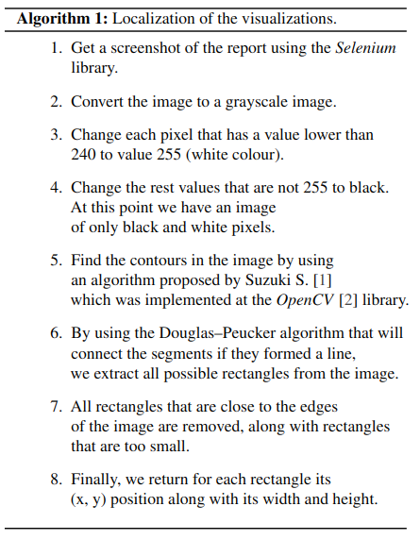


Data extraction
Crawler implemented with Selenium
Localization of the visualizations
Assumptions about the colouring

Slide 10
Data Comparison – Challenge
Country | Club | Titles | League | B.Player
Spain | Barca | 1 | 1 | Messi
Spain | Real | 0 | 1 | Ron.
Spain | Real | 0 | 2 | Diaz
France | PSG | 1 | 1 | Nem.
Club | Country | B.Player | Titles | League
Barca | Spain | Suarez | 0 | 1
PSG | France | Cav. | 1 | 1
Real | Spain | Benz. | 1 | 1
Real | Spain | Diaz | 0 | 2

Slide 11
Data Comparison – Challenge
Country | Club | Titles | League | B.Player
Spain | Barca | 1 | 1 | Messi
Spain | Real | 0 | 1 | Ron.
Spain | Real | 0 | 2 | Diaz
France | PSG | 1 | 1 | Nem.
Country | Club | Titles | League | B.Player
Spain | Barca | 0 | 1 | Suarez
Spain | Real | 1 | 1 | Benz.
Spain | Real | 0 | 2 | Diaz
France | PSG | 1 | 1 | Nem.

Slide 12
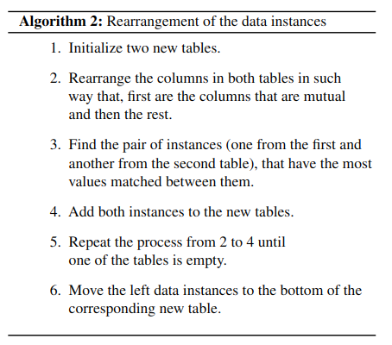
Data comparison
Rearrangement of the data instances
What is interpreted as a difference?
Difference in values
One of the values is NaN
Both of the values are NaN
Different string values
Equal string values

Slide 13
Data Comparison – Challenge
Country | SY | PY
Spain | 125 | 126
France | 303 | 305
Country | SY | PY
France | 125 | 126
Spain | 303 | 305
But, maybe the difference is actually in the key value?

Slide 14
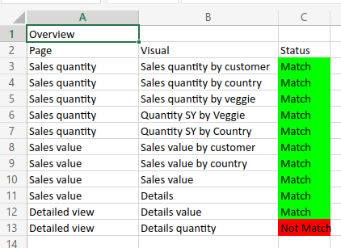
Results output
Overview
Report
Number of rows
Number of columns
Difference in values

Slide 15
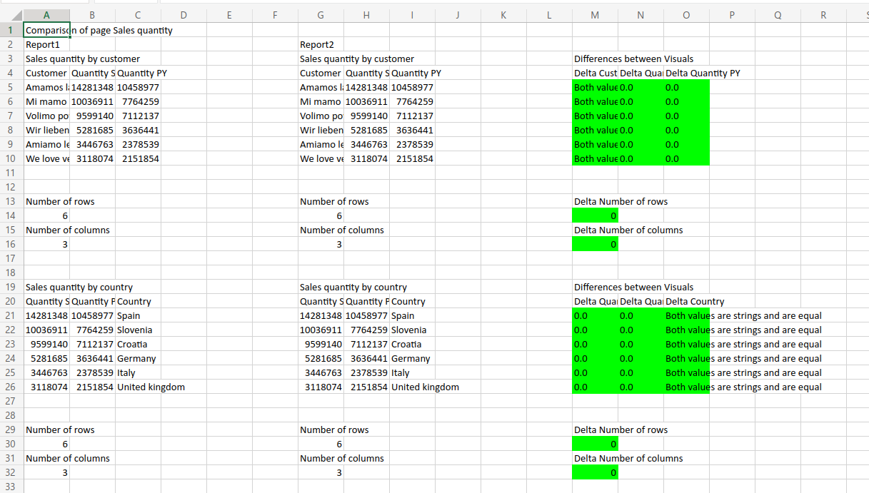

Slide 16
Discussion
What was achieved?
Why we did not use any conventional Data Science Methods?
Limitations
Assumption about the colour of the visualizations and the report’s background
Time complexity of the rearrangement algorithm
Get the algorithm closer to the real arrangement
Further improvements
Deep Learning for image segmentation
Extract the data directly from Power BI Desktop
Add Docker

